Slide 1
ELEMENTARY PE
GRADING RUBRIC

Slide 2
STUDENT
ASSESSMENT

Slide 3
BE MINDFUL
Did you follow class rules and routines?
2. Did you display good sportsmanship?
3. Did you participate and give your best effort during warm-up exercises and the activity?
4. Are you getting better at performing the skills of the activity?

Slide 4
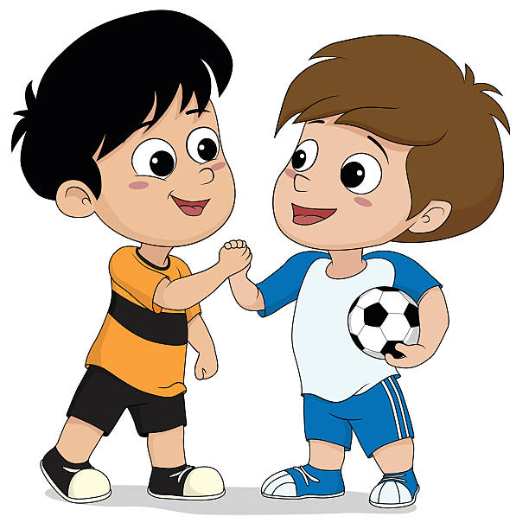
SCORING RUBRIC
4
PERFORMANCE: I am extremely confident I can perform all the skills used in the activity better than most students in my grade, and I can teach a peer how to do the skills.
BEHAVIOR: My behavior today was excellent, and I displayed good sportsmanship above and beyond expectations!

Slide 5
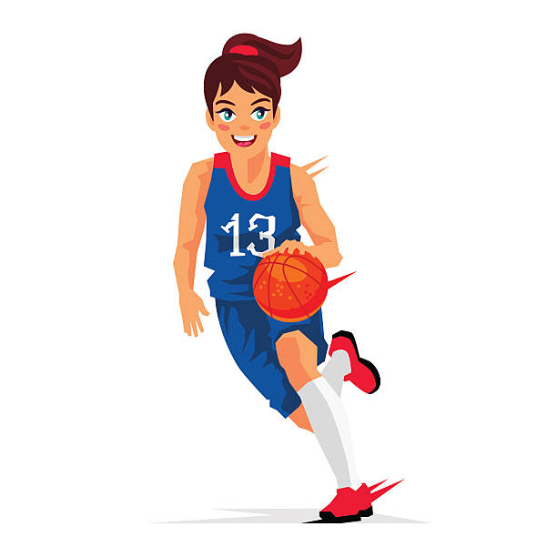
3
PERFORMANCE: I am extremely confident I can perform most of the skills used in the activity as well as most of the students in my grade.
BEHAVIOR: My behavior today was good, and I displayed good sportsmanship as expected!

Slide 6
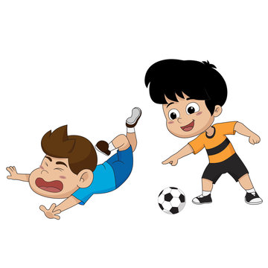
2
PERFORMANCE: I can perform some of the skills used in the activity as well as most of the students in my grade.
BEHAVIOR: My behavior today could use some improvement, and I need to display good sportsmanship more consistently!

Slide 7
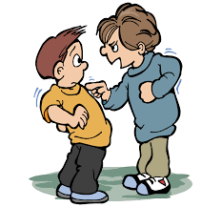
1
PERFORMANCE: I am having trouble performing most of the skills used in the activity as well as most students in my grade, or I forgot my sneakers.
BEHAVIOR: My behavior today was not acceptable, and I need to focus on displaying good sportsmanship!

